Slide 1
ComSSA DSA Revision
Semester 1, 2023

Slide 2
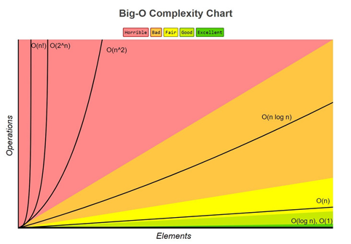

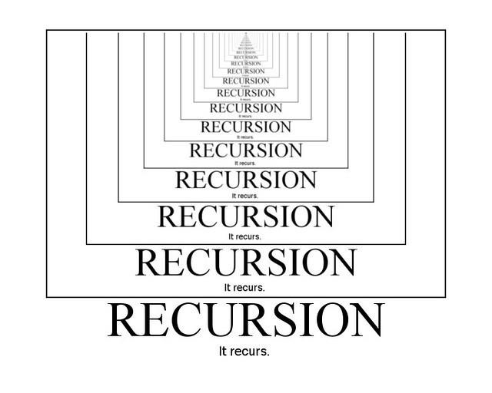


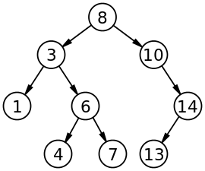
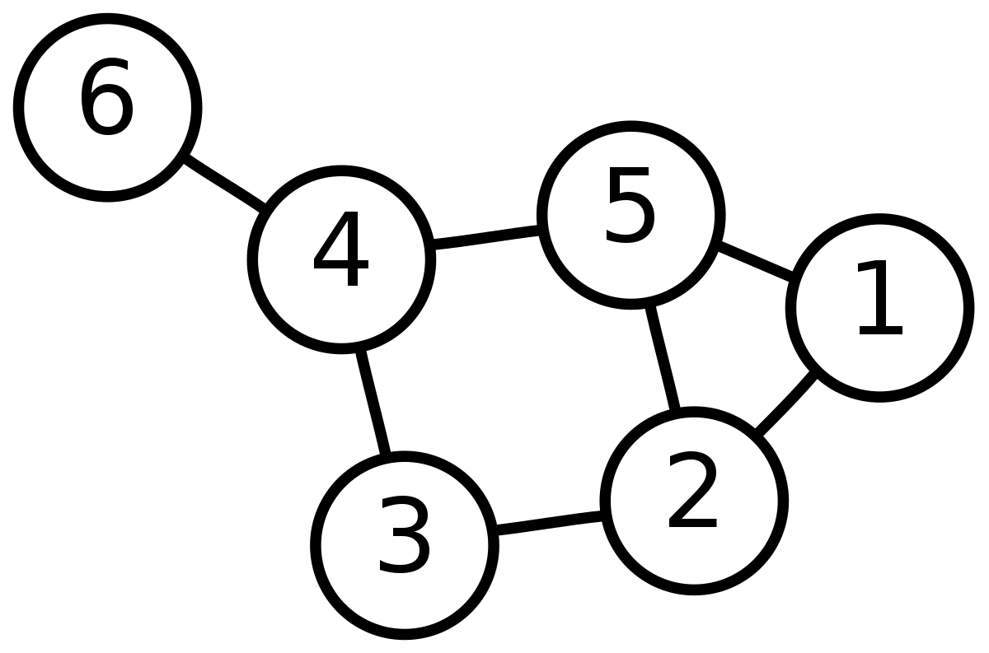
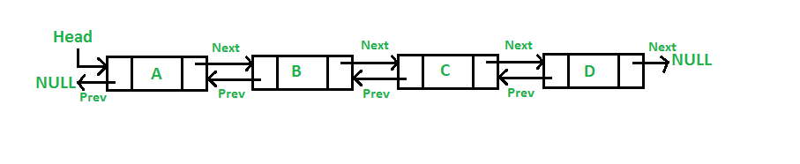
A quick overview, Week 1–6

Slide 3
We won’t repeat the lecture notes.
This is going to zoom in on some specific issues:
Clearing some mysteries
Looking towards the mid-semester test
We will make more in-depth slides developed by ComSSA available to you.
We’re happy to take questions about anything you’ve covered or want to better understand at the end of the session.

Slide 4
Big O
Later units, and many online materials, will take a deep dive on this topic. DSA keeps it fairly simple, and so will we.
Order | Example
O(N²) | For loop inside a for loop (Week 1 sorts)
O(N log N) | Tree navigation (Week 5), Merge Sort (Week 9)
O(N) | A for loop, or iterating through an object
O(log N) | Search for one element in a tree
O(1) | Maths operations, finding an array position
Decreasing

Slide 5
What does “Big O” mean?
Not required knowledge, but may help explain it. Imagine a maths equation from high school:
4n² + 6n + 4
(Don’t worry, we’re computer scientists, not maths teachers.)

Slide 6
What does “Big O” mean?
Now let’s make n really big – let’s say, a trillion.
4n² + 6n + 4
(Don’t worry, we’re computer scientists, not maths teachers.)

Slide 7
What does “Big O” mean?
Now let’s make n really big – let’s say, a trillion.
4n² + 6n + 4
(We are also not artists. Sorry.)

Slide 8
What does “Big O” mean?
If we optimised the part of the program that is 6n or 4, it would make no difference at all to how it runs.
4n² + 6n + 4

Slide 9
What does “Big O” mean?
Nor does the scale. n log n isn’t much bigger than that middle box.
4n² + 6n + 4

Slide 10
What does “Big O” mean?
Nor does the scale. n log n isn’t much bigger than that middle box.
O(n²) + 6n + 4

Slide 11
A quick diversion - UML
In DSA we use UML for each of the pracs, and for the final assignment.
Very high level view of our classes and their interactions. They don’t include constructors, constants, logic or any other part of the implementation. Basically it is a “user guide” for what to send to the classes, and what one can expect to receive back from them.
They are language independent – they should look the same whether they end up coded in Python, Java or something else.

Slide 12
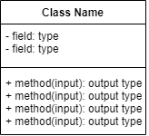
A quick diversion - UML
This is how a class looks. The fields (variables) have a “-”, then their name, and their type.
The methods have a “+”, any inputs in brackets, and their output types.

Slide 13
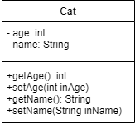
A quick diversion - UML
This is an example provided by Valerie. Note that setAge and setName have no output, so there’s no output (return) type. The inputs (parameters) are shown in brackets, but if there is no inputs, we use ().

Slide 14
A quick diversion - UML
Constructors use our classes as templates to create objects. The object is a unique instance of the class.
name: “Iris”
age: 5

Slide 15
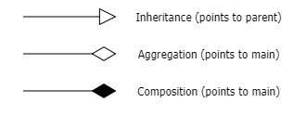

A quick diversion - UML
We use arrows to link the classes.
Test harnesses do not need very much detail at all. This is usually sufficient:

Slide 16
Test harnesses (simplified)
Reality
Output
What we know to be true
?
=
What our program tells us
Yes - PASS
No - FAIL

Slide 17
Test harnesses (simplified)
Test harnesses should test every method in every class.
Should also test for:
Reliability - Does what it is supposed to do, follows the specification
Robustness - Copes with whatever is thrown at it. (Pop from an empty stack?)
And importantly, display everything!

Slide 18
Stacks and Queues
Stacks are “Last In, First Out” – they behave like a tube of tennis balls. When we pick one out, it’s the last one to have gone in.
Queues are “First In, First Out” – they behave like a queue of shoppers at the supermarket. The shuffling queue sees them all step forward when the front person is let in. (The circular queue reduces time complexity by just moving two pointers.)

Slide 19
Linked Lists
A linked list consists of two classes, LinkedList and ListNode. LinkedList is literally just a pointer to the head node (first node).
ListNode contains a value and a pointer to the next node.
value
value
value
value
next next next

Slide 20
Linked Lists
In the prac, you were asked to make it a “doubly-linked, doubly ended” list.
We do this by adding a “tail” pointer to the LinkedList and “prev” pointers to the nodes.
value
value
value
value
next next next

Slide 21
Linked Lists
In the prac, you were asked to make it a “doubly-linked, doubly ended” list.
We do this by adding a “tail” pointer to the LinkedList and “prev” pointers to the nodes.
This makes accessing the end of the list much easier.
e.g. insertLast doesn’t have to iterate through the entire list.
value
prev prev prev
value
value
value
next next next

Slide 22
Activity 1
Given a doubly-linked, doubly ended list.
How would you perform an insert on the first node?
What if you perform a remove on the first node?
(We just want to know how would you re-arrange the pointers?)
value
prev prev prev
value
value
value
next next next

Slide 23
Iterators
These poor, misunderstood little creatures only want to help!
Remember with arrays when you did:
You were using an iterator and didn’t even know it!
for i in myArray: for (i : myArray) {}

Slide 24
Iterators
So if you want to do this:
Follow the instructions in lecture 4. You don’t need to create any special objects. The iterator allows your objects behave like the native Java/Python ones already do.
for i in myLinkedList: for (i : myLinkedList) {}

Slide 25
Binary Trees
A binary tree consists of two classes (again), BinarySearchTree and TreeNode. BinarySearchTree is just a pointer to the first two nodes (left and right).
It also contains all the methods for inserting, deleting, finding, etc.
ListNode contains a key value pair, and their corresponding left and right pointers.
We use the key for building the structure of our tree, i.e., to divide the data in branches.

Slide 26
Binary Trees
If we get a set of numbers as keys: 10, 9, 23, 11, 6, 8, 30
10
9
23
6
11
30
8

Slide 27
Binary Trees
Complete Tree
11
9
23
There’s 3 main types of trees:
Degenerate Tree
6
10
13
30
10
16
Almost Complete Tree
11
23
9
23
25
6
10
40

Slide 28
Binary Trees – Traversals
Three types – the name gives away where the parent node appears:
Pre-order Parent, Left, Right
In-order Left, Parent, Right
Post-order Left, Right, Parent
(This may be a useful memory aid in a closed book test)

Slide 29
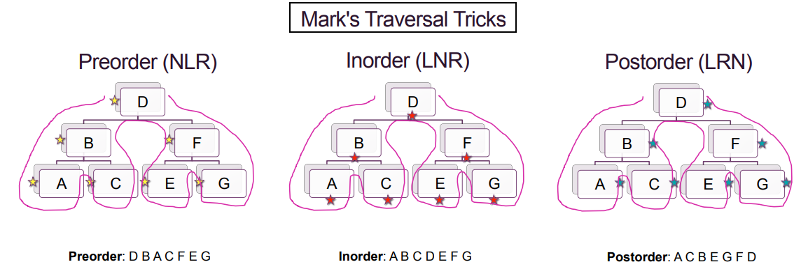
Binary Trees – Traversals
(Credit: DSA Lecture 5, slide 78-83)

Slide 30
Activity 2
In your groups, draw out the binary search trees for each of these sets.
Is this an efficient tree? Why or why not? (Hint: Lecture 5, slides 60-63)
Do ONE traversal for the FIRST tree* - pre-order, in-order or post-order. Check your answer on https://yongdanielliang.github.io/animation/web/BST.html (Note: Try it first THEN check, you won’t have this site available in the test!)
a) 50, 60, 40, 45, 55, 75, 90, 15
b) 15, 35, 45, 75, 55, 95, 100
c) 60, 40, 80, 30, 70, 50, 90, 45
* Try the others in your own time at home.

Slide 31
Graphs
These are basically “networks” from high school maths.
We call the nodes “vertices” and the links between them “edges”.

Slide 32
Graphs
In DSA we have two designs for them: a simpler one using just vertices and only “implying” edges, and a more complex one with vertex and edge objects.

Slide 33
Graphs
In DSA we have two designs for them: a simpler one using just vertices and only “implying” edges, and a more complex one with vertex and edge objects.
Design 1
Graph
B
v
V
V
V
V
v
A
v
v
C
v
v
(Some arrows omitted for simplicity)

Slide 34
Graphs
In DSA we have two designs for them: a simpler one using just vertices and only “implying” edges, and a more complex one with vertex and edge objects.
Design 1 Design 2
Graph
B
Graph
v
B
v
ab
E
V
V
V
V
A
E
E
E
E
V
V
V
V
E
v
A
v
E
bc
E
ac
C
v
C
v
E
E
(Some arrows omitted for simplicity)

Slide 35
ComSSA Revision – Thank you for coming!
Thank you!
For more information about ComSSA, please visit http://www.comssa.org.au or ask our friendly team for more information!
We will be available on #dsa-revision on the ComSSA Discord server

