Slide 1
ComSSA DSA Revision
02/04/22

Slide 2
Abstract Data Types (ADTs)
A data structure is a means/format of organising and storing data in a way that makes it easier to access/add/remove said data (but not necessarily all at once)
An abstract data structure is a data structure that defines the operations for manipulating its data, but now how that structure is implemented exactly
  e.g. Stacks and queues - both can be implemented with either an array or a linked list

Slide 3
Arrays
Simple means of storing sets of data
Built into most popular programming languages
Contain many elements
These elements are stored sequentially in memory
  i.e. the entire array is a contiguous block of memory
All elements must be the same data type
Can be set to any size, but cannot be resized
  Must create a new array and copy over contents of old array in order to “resize” an array

Slide 4
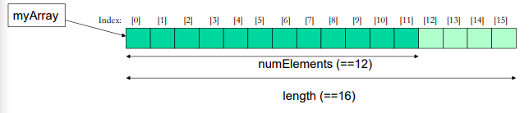
Arrays Contd.
Elements of an array are accessed via an index (sometimes called a subscript)
Most languages start counting the index from 0
  ie the index counts the distance from the start
(Shamelessly stolen from Dr. Maxville’s week 1 lecture slides)

Slide 5
Pros and Cons of Arrays
Pros:
  Fast, O(1) (we’ll get to big O soon) access to *any* element in the array
    Accessing is just an addition operation, i.e. array location + index
  No extra storage overhead - each element exactly fits data
Cons:
  Fixed size: Cannot be grown/shrunk
  Can’t insert new element at the front without shuffling all other elements down
  Doesn’t track how many elements are in use (and when you’re not using the whole array, you’re wasting space)

Slide 6
Time Complexity
With computers, the actual time in seconds it takes to accomplish something is not a useful way to measure an algorithm since better hardware = faster
Instead, we describe how many steps are needed; this is independent of hardware speed
Steps ~= CPU instructions
That being said, we can’t know exactly how many instructions are actually involved with a “step” and different CPUs have faster/slower or broader instruction sets that may make them better at some tasks than other CPUs

Slide 7
Big-O Notation
The way we describe the number of steps is by describing how the algorithm scales with more data
  We want to know if the algorithm will handle lots of data well, or if will quickly become too unwieldy
Big-O exists for this purpose
  Describes “order-of” the algorithm (ie what ballpark it’s in)
  Notation: O(<numSteps>), e.g. O(N), O(N log N), O(1), O(N²)
  Ignores constant multiples
    Only concerned with scalability as amount of data increases
    O(N) means “double the data N, and you double the time)
    O(N²) means “Triple the data N, and you 9x the time”

Slide 8
Basic Big-O Example
Imagine an algorithm where we check one-by-one for a value in an unsorted array (Sometimes called a linear search, or a naive search)
  Best case: the value is in array[0]
    This is one step, so O(1)
  Worst Case: the value is at the end of the array, which is N steps
    This N steps, so O(N)
      Each step involves multiple actual cpu instructions but we don’t care about that, so we don’t do O(5N) or anything like that
  Average case: halfway, so N/2 steps
    Since we ignore the /2 part, this is O(N) again
  Average and worst cases are usually what we’re interested in (although not always!)

Slide 9
Binary Search
Linear search is ok, but it could be better
A faster alternative: Binary search
  Only works on sorted data
  Methodology:
    Check the middle
      If thisis too low, jump halfway to the end
      If thisis too high, jump halfway to the start
    Repeat the last step with the “end” being the last value you jumped down from and the “start” value being the last value you jumped up from

Slide 10
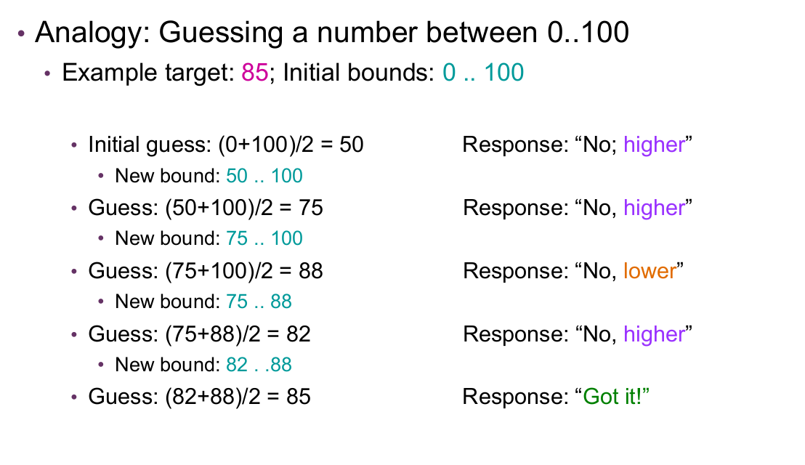
Example Binary Search
Shamelessly Stolen from Dr Maxville’s week 1 lecture slides

Slide 11
Binary Search Contd.
Search time complexity:
  Halving bounds on each iteration, means at most log 2 N iterations
    Since after log 2 N, the bounds will shrink to one element in size
  Average/Worst Cases: O(log N)
    Best case: O(1), but that only happens due to luck!
Lends itself to recursive implementation
  Change the bounds and repeat on the simpler sub-problem
  Base cases: 1) target found OR 2) bounds are equal (i.e., not found)
An iterative solution isn’t more difficult
  You don’t need to remember past upper/lower bounds
    Unlike MergeSort or QuickSort, which has to keep track of all merge indexes
REMEMBER - Still only works on sorted data
  This means that it’s actually quite slow if you sort JUST to do one search
  Useful if you repeat the search many times to take advantage of having sorted it

Slide 12
Sorting
Why sort?
  We often need to present data, and having it organised can make it easier to understand
  More efficient processing
    Selecting a range for data is simple
      e.g. if you wanted to grab data relating to a range of dates or ratings
    Searching, like we just discussed
Time complexity
  Sorting involves handling all N items, to put them in order
  O(1) sort is impossible, since we need to check all N items to see if they’re even in order
  So O(N) is the absolute minimum, so pretty much when the elements are already sorted, which isn’t exactly common
  Average Case will be worse than O(N)

Slide 13
Sorting Contd.
What average-case time complexities can we hope for when sorting?
  Naive approaches often become O(N²)
  More sophisticated approaches are O(N log N)
    Also: it’s been proven that no general sorting algorithm can be faster than O(N log N) for its average case
      it it is possible to be faster when taking advantage of properties of certain data
      e.g. radix sort is O(kN), but needs integer data with a known min and max
Remember: focus on average and worst cases
  Why care about best case when average will happen the most
  Worst case also matters: sometimes things can get pretty bad

Slide 14
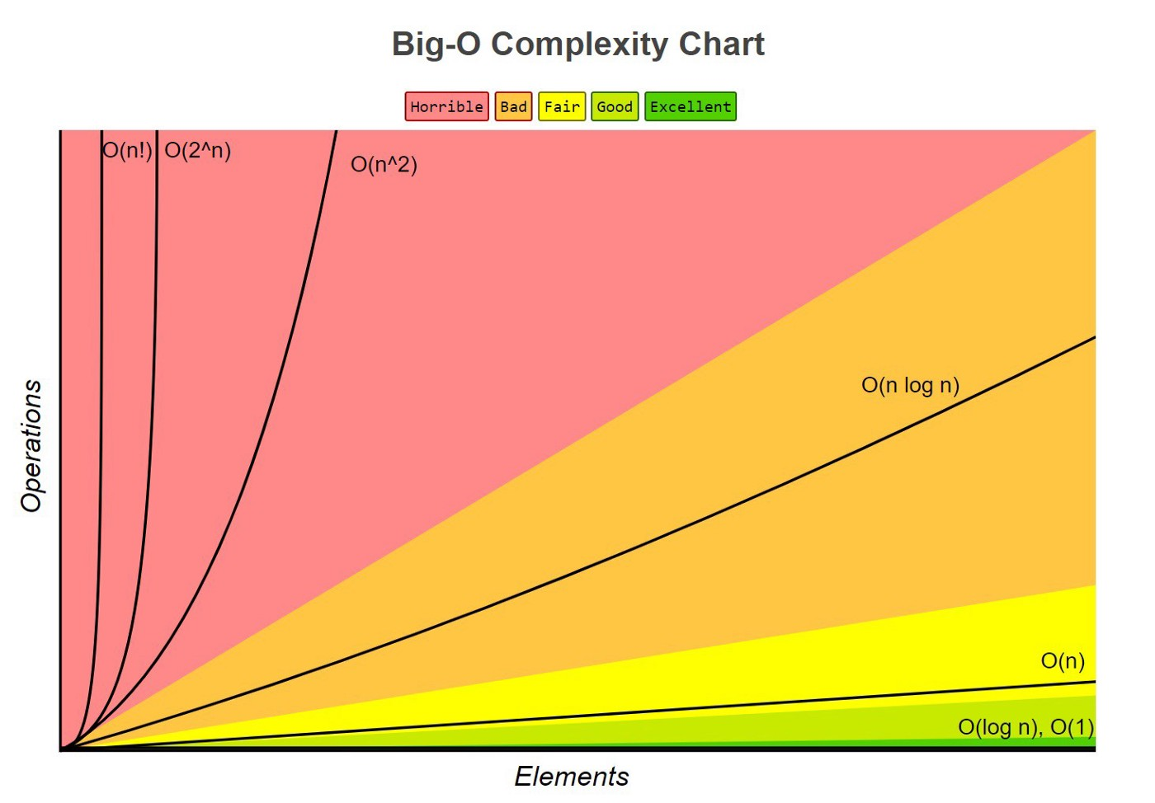
Big O Comparison visualised
Taken from this medium article: https://medium.com/swlh/basics-of-big-o-notation-7d5d905d058d

Slide 15
O(N²) Algorithms
Ones we’ll be covering:
  Bubble sort
  Insertion Sort
  Selection Sort

Slide 16
Bubble Sort Strategy
Check every adjacent pair of values and swaps them if the “higher” one has the “lower” value and vice-versa
  An entire pass through an array isn’t enough, need multiple passes to sort
  Each pass “bubbles up” the biggest value to the end
Some optimisations:
  Can stop sorting when no swaps were done in a pass (this means the array is sorted
  Don’t check the last P values in the array (where P is the number of passes)
    Every pass will place the single largest value unsorted into its “true” location

Slide 17
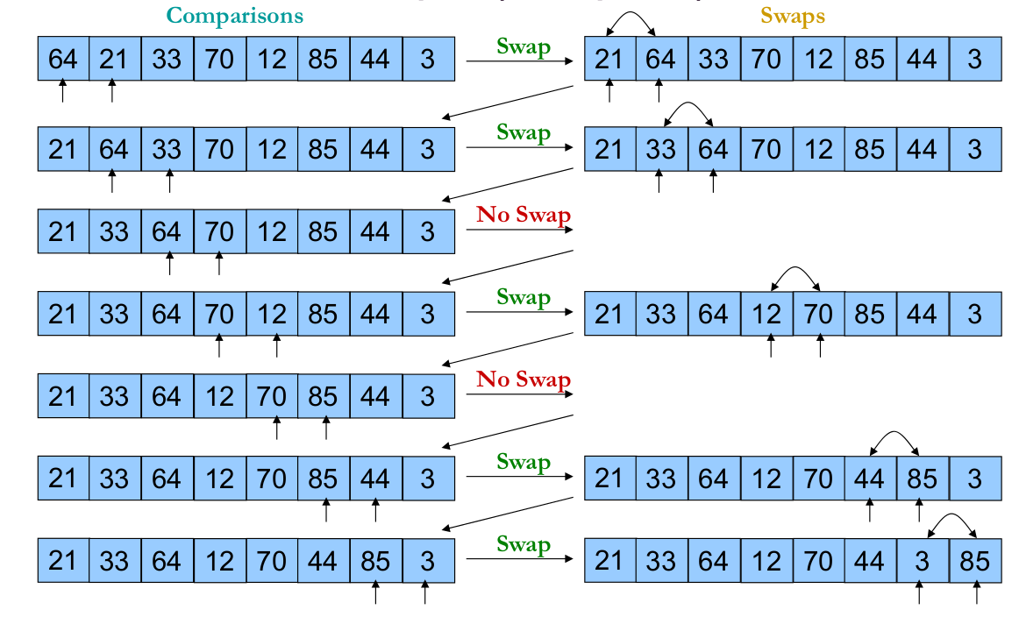
Bubble Sort Example (One Pass, Not a Full Sort)
Also stolen from Dr. Maxville’s week 1 slides

Slide 18
Bubble Sort - Pros and Cons
Pros:
  Simple to implement
  Could finish early if we get lucky (ie if data is sorted or almost-sorted)
    Almost-sorted specifically meaning that smaller elements start near their final position
    This is rare so things usually degrade to O(N²)
Cons:
  Lots of work per pass: constant swapping
  Very slow on reverse-ordered data
    Ends up swapping everything on every pass

Slide 19
Insertion Sort Strategy
Basically, adds things in sorted order
  So when we add a new item, we find where it should go
We can also use this idea to sort an existing array
  This is done by Considering the first number to be a sorted section of length 1
  Then we insert the next number at the very start and then swap it up until it is in order for the sorted section (like a pass of bubble sort, just in this “sorted” section)

Slide 20
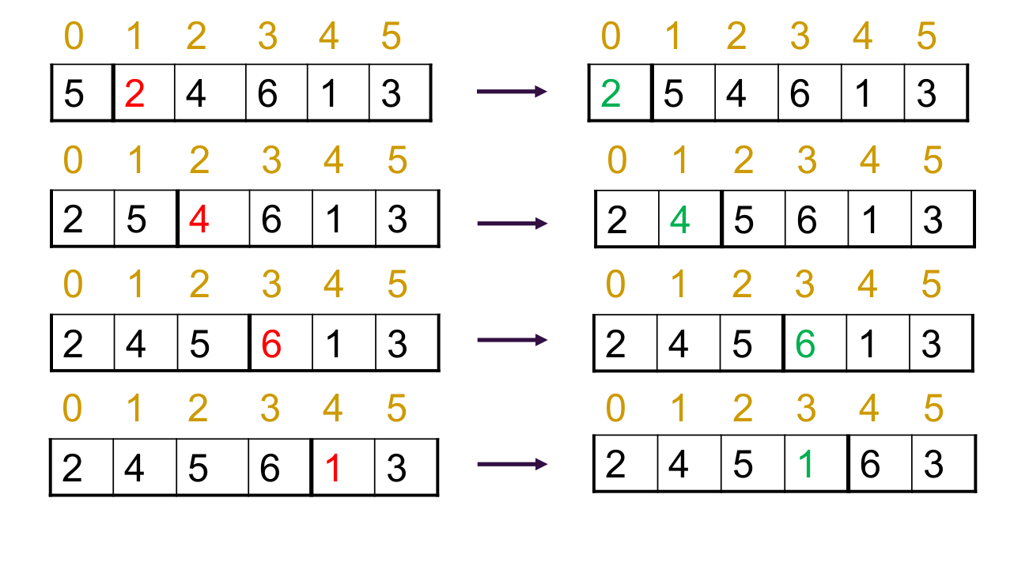
Insertion Sort Example
Taken from Dr. Maxville’s week 1 slides

Slide 21
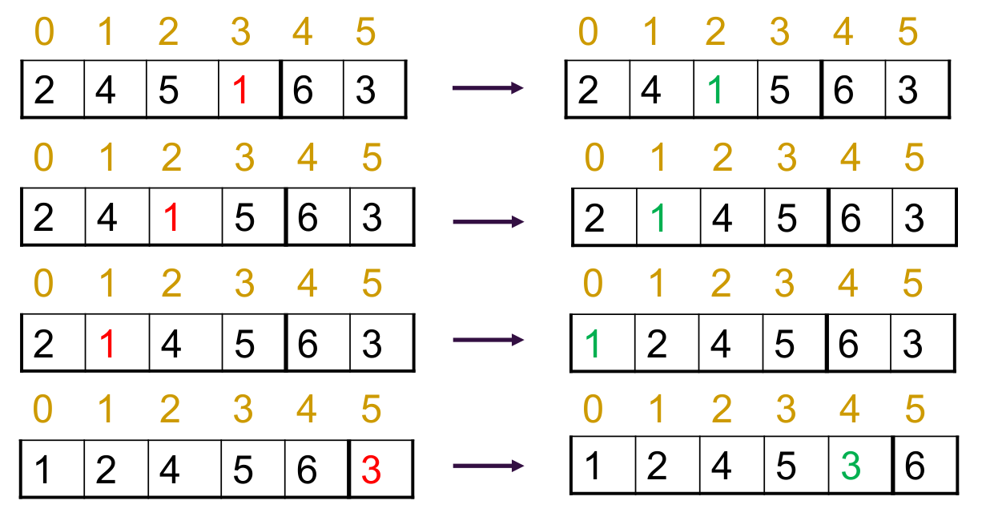
Insertion Sort Examplep Contd.

Slide 22
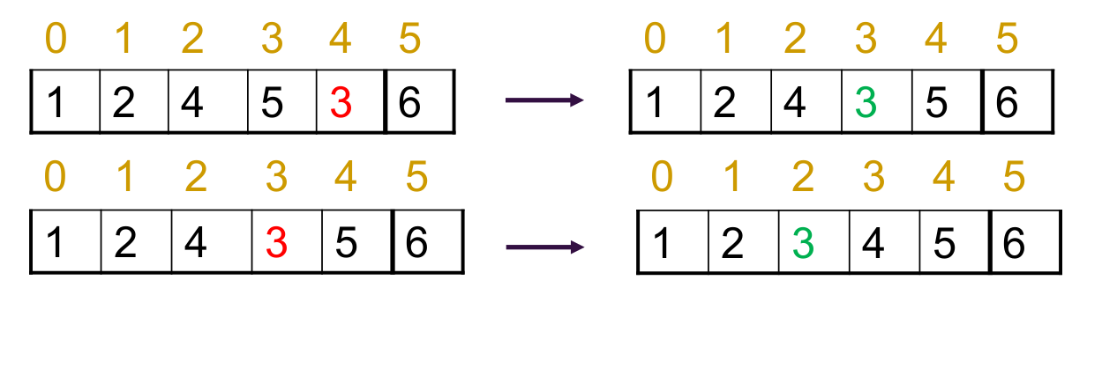
Insertion Sort Example Contd.

Slide 23
Insertion Sort - Discussion
Although it looks similar to Bubble sort in terms of its time complexity, it’s generally superior
Better with semi-sorted data
  Elements go to their sorted position directly
  Shell sort is a faster O(N^{3/2}) variant that takes advantage of semi
Although insertion sort still does a lot of swaps
On average, P/2 Compares + P/2 swaps (P = number of passes)

Slide 24
Insertion Sort - Pros and Cons
Pros:
  Very fast with almost-sprted data (minimal swaps and compares
    Performance also degrades “gently” from best case
  Stable sort
Cons:
  Conceptually trickier than other O(N²) sorts
  Lots of swaps, since larger elements get shuffled up
  Also very slow on reverse-ordered data

Slide 25
Selection Sort Strategy
Select the smallest item and swap it with the first item
Repeat for the second-smallest item
Repeat until finished

Slide 26
Selection Sort - Discussion
N-1 passes total
One swap per pass
Always N-1 passes of N-P compares + 1 swap
  Thus Best = Average = Worst case
  Complexity: O(N²)

Slide 27
Selection Sort - Pros and Cons
Pros:
  Easy to implement
  Minimal work per pass - only one swap
  Best case = average case = worst case
    This may not sound ideal but this consistency can be considered good depending on the situation
  In-place
Cons:
  Unstable sort

Slide 28
In-Place Sorting
These three algorithms we’ve looked at don’t require much temporary storage - only need a temp variable, and maybe an index or two
This makes them “in-place”, meaning they’re sorting the array without creating a new array and copying things over
Some other algorithms are not in-place, which can be a problem for very large datasets if they take up too much RAM

Slide 29
Stable vs Unstable
Sometimes sorts will end up swapping identical values even if they’re identical in terms of where they sit in the “order”
Why is this an issue?
  Often we’re not sorting single values, but by single parts of more data; such as by the student ID of a Student Object
  This requires us to sort by the designated “sorting key” of the object (like the student example)

Slide 30
Recursion
Recursion is, simply put, when a function calls itself
This lets us solve problems where we state the problem in terms of simpler versions of itself
It’s also a type of repetition (like loops)
Some problems are MUCH easier to solve with a recursive approach than an iterative one(ie what you normally do until now)

Slide 31
Factorial Example Java
Iterative:
public long calcNFactorial( int n)
{
Long nFactorial = 1;
for( int i = n; i >= 2; i–; )
nFactorial *= i;
return nFactorial
}
Factorial:
Public long calcNFactorialRecursive( int n)
{
if ( n == 0) //Simplest case (“Base case”)
return 1;
else
return n * calcNFactorialRecursive( n - 1 ); //Recursive call multiplied by n, eventually heading towards base case
}
PLEASE IGNORE MULTIPLE RETURNS IN THE METHOD, THEY’RE STILL NOT ALLOWED IN THIS UNIT

Slide 32
Factorial Example Python
Iterative:
def calcNfactorial( n ):
nFactorial = 1
for i in range( n, 1, -1 ):
nFactorial = nFactorial * i
return nFactorial
Recursive:
Def calcNFactorialRecursive( n ):
if n == 0:
return 1
else:
return n * calcNFactorialRecursive( n - 1)
PLEASE IGNORE MULTIPLE RETURNS IN THE METHOD, THEY’RE STILL NOT ALLOWED IN THIS UNI

Slide 33
Required Properties
A recursive algorithm should be:
  Decomposable into a simpler version of the same form
    e.g. N! Is easy to calculate if (N-1)! Is known
  One or more base case(s) exist (and are not recursive)
    Like when n == 0, no factorial was needed - just return 1
  Base case must be reached eventually
    Meaning at least one parameter must be changed every recursive call, changing towards the base case (otherwise the recursion will never end)

Slide 34
Call Stack
Whenever a new method is called, its data needs to be stored
  The method’s local variables, a copy of the method’s parameters, and some other data such as an address to return to afterwards
Since methods are processed in a last-in-first-out order, the information is placed on a special stack in memory
This is called the Call Stack

Slide 35
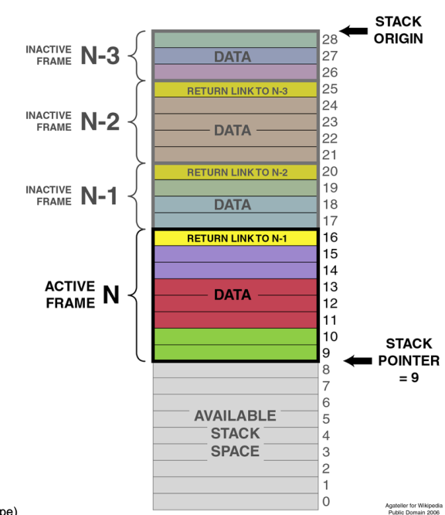
Call Stack Diagram
Every successive method call puts
another stack frame on the stack
This goes for all method/function calls,
not just recursive calls
Stolen from Dr Maxville’s Week 2 slidse

Slide 36
Stack Overflow
A recursive algorithm with hundreds of recursive calls means hundreds of stack frames
  Call stacks are usually limited to around 10MiB or so
  Thus too many calls can lead to the program running out of stack space
  If this happens the program will crash

Slide 37
Stacks and Queues
Two very common abstract data types
  Queue: take things out in the order they were added (FIFO: First in First out (although not all queues are FIFO))
  Stack: Take things out in reverse order (LIFO: Last in first out)
  Elements must be taken out in order; you can’t jump in and grab something from the middle
Note - Arrays are not necessarily best for implementing these ADTs

Slide 38
Stacks
A stack is an ADT that implements a LIFO list
  Think of a stack of books - put something on the top, take something off the top
    Useful for evaluating math expressions, storing information for method calls, converting strings into ints etc.
Stack Methods:
  push() - add an item to the top of the stack
  pop() - take the top item off the stack
  top() - returns the top of the stack, but does not remove it (also called peek() )
  isEmpty() - check if the stack is empty
  Sometimes also:
    isFull() - useful if implemented with an array
    count() - number of elements in the stack

Slide 39
Queues
A FIFO queue is an ADT implementing a FIFO list
  Other kinds of queues aren’t FIFO, like a priority queue
  Useful for things like bank transactions processed in order, customer orders being processed in-order, etc.
Queue Methods:
  enqueue() - add to the back of the queue
  dequeue() - take off the front of the queue
  peek() - returns but does not remove the front of the queue
  isEmpty() - check if queue is empty
  Optional Methods:
    isFull() - check if queue is full (useful for array-based queues)
    count() - number of elements in the queue

Slide 40
Arrays Considered Harmful
(The title is a joke)
As a data structure, we know that arrays have some shortcomings:
  Fixed size
  Insertion (requires shuffling if we insert an element between two existing elements)
  Contiguous in memory
    Yes, this is sometimes a disadvantage - it’s inflexible
Enter: the linked list

Slide 41
Linked Lists
The basic idea:
  Store a value, and a reference to the next element
  That next element also stores a value and a reference to the next element
  This becomes a “chain” of links
  The list itself only stores the first element, and we can access the other elements by travelling through those references
Since each element only points to the next, it is “singly-linked”
  And since the list only points to the head, it is “singly-ended”
Some more complicated lists linked both forwards and backwards, and/or also store the head
  This can make some operations faster
These also come up in UCP !! Make sure you understand them

Slide 42
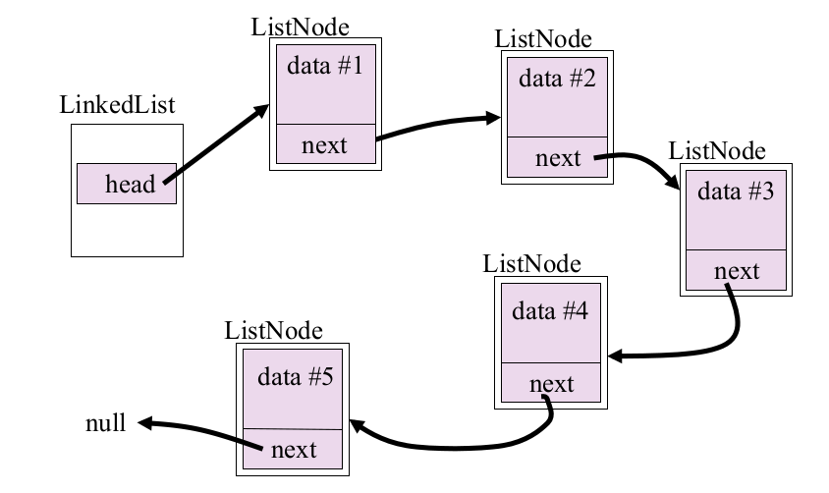
Linked List Diagram
Taken from Dr. Maxville’s week 4 slides

Slide 43
Traversing Linked Lists
A linked list is just a chain of connected-but-independent nodes
  Each node could be anywhere in memory
  Only the node’s predecessor knows where it is
  So to get to the 6th node we need to get to the 5th, which we access from the 4th, which we access from the 3rd… etc.
Only the first node is directly available, meaning we have to travel across the whole list to get to the element we want to get to
  This is much slower than an array, which can get to any element in one step
This is a linked lists’s biggest issue; access time

Slide 44
LinkedList Methods
isEmpty() - true if the list is empty
insertFirst()/insertLast()/insertBefore(valuetofind) - insert an item
removeFirst(), removeLast() - delete an item from the list
peekFirst(), peekLast() - return the value of a node without removing it
find(valuetoFind) - search whether a value exists in the list

Slide 45
LinkedLists Over Arrays
Advantages:
  Can grow and shrink with data - no space wasted
  No limits on size (except for actual memory)
  Easy to insert items in any part
Disadvantages:
  Access time os N/2, so O(N) (as opposed to O(1) for arrays)
  Storing a pointer to the next node is overhead for memory usage

Slide 46
Iterators
Traversing over elements in a dataset is pretty common
And also a little inconvenient to write out
Enter: Iterators
  An Object that can return the “next” value in a data structure while you use it (the next() method in java, __next__() in python)
  hasNext() in java returns true if there are any more elements in the data structure
  remove() removes the last item returned - although this is optional

Slide 47
Trees
A tree is a kind of data structure that used to represent a hierarchical relationships
  Still stores a set of values, but now the set is ordered hierarchically rather than in a line
Examples of trees irl:
  Family tree
  Command structure in a military organisation
Examples in computing
  Binary search trees, heaps
  File systems

Slide 48
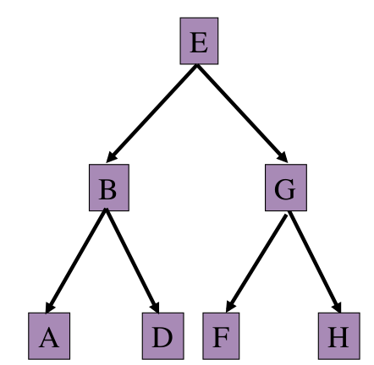
Binary Search Tree (BST)
Each node has 0, 1 or 2 children
  Left child and right child
Each node has a key that is used to organise the
Tree in a sorted way
  Keys must also be unique - for searching
Nodes also need a value (not shown in diagram)
Sorting is “horizontal”
  Left children are smaller than parent
  Right children are larger than parent
Diagram from Dr Maxville’s week 5 lecture slides

Slide 49
Tree Methods
find() - this is fast in a bst, as the tree structure makes it faster to find things (similar to binary search from earlier)
  In a (properly-maintained) tree this will halve the number of node we consider each time we move down a branch
  We only ever end up checking at most one node for each level in the tree (less if the item is not a leaf node)
  Implemented recursively
insert() - like find, except we’re looking for where a node goes instead of finding a specific node
  Always adds the node to the bottom branch of the tree
    Inserting in the middle is way too messy
  Also implemented recursively

Slide 50
Tree Methods Contd.
delete() - can be complicated because the tree needs to be reshuffled if the node has children
  There are three cases when deleting:
    The deleted node has no children
    The deleted node has one child
    The deleted node has two children
    In all three of these cases, we have to locate the node to delete first (find() can be useful for this)

Slide 51
Types of Trees
When evaluating the efficiency of a tree we need to know its exact structure
  This is because tree nodes can have 0, 1 or 2 children; a tree will not always be perfectly “balanced”
The three main types:
  Complete binary tree
    All nodes have two children except for the last level, which have zero children
    Fits the most nodes in the fewest levels - optimal compactness
      This is important because number of levels = max number of comparisons for searching
  Almost-complete binary tree
    A more realistic scenario
    Mostly a complete tree but without enough nodes to fill in the last level
      Should be filled left-right (useful when storing binary trees in an array (e.g. heaps))
  Degenerate binary tree
Also:
  Strictly binary tree: all nodes have 0 or 2 children
  Balanced binary tree: roughly the same number of branches on either side of nodes in the tree

Slide 52
Time Complexity: (Almost)-Complete Trees
find()
  Best case - O(1), root is what we want
  Worst case - key is on the last level, so O(log N) (both a complete and almost-complete tree are 1 off of each other in terms of levels, so they have the same complexity)
  Average case: key is 2nd last level , so also O(log N) (remember the tree doubles in size every level)
insert()
  Best case: we insert at the last level, so O(log N)
  Worst case: also O(log N)
  Average case: O(log N)
delete()
  A find() plus promoting the “successor” node
    Best, average and worst cases are all also I(log N)
      No children - leaf nodes at the bottom of the tree
      One child - must be 2nd last level
      Two children - no matter where the node is, its successor must still be at the bottom

Slide 53
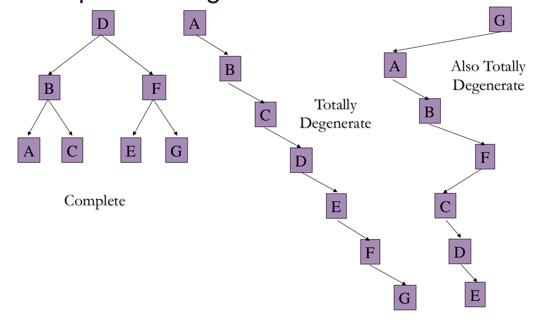
Degenerate Trees
The other extreme of things: the most inefficient a tree can be
Completely degenerate when
every node just has 1 child
until the last level
This is effectively a linked list
with extra steps lol
If this happens, it can be
“Rebuilt” to become balanced
Again
Taken from week 5’s slides

Slide 54
Degenerate Trees Contd.
Since a fully-degenerate tree is a linked list, all time complexities are the same:
find/insert/delete: Best = O(1), Average = O(N), Worst = O(N)
  Although the best case is better, since it’s rare it’s usually a fair bit worse

Slide 55
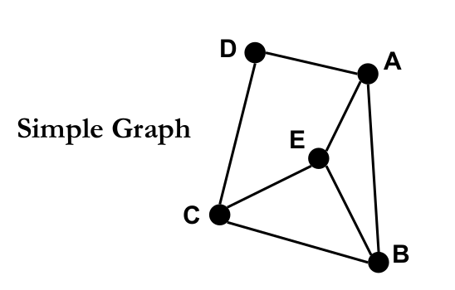
Graphs
A set of nodes that can have any number of connections to other nodes
These connections are called “edges” and a node is called a “vertex” (the plural of vertex is vertices)
Defined completely by these vertices and edges; there are many structures in the real world these can model
  Vertices could be cities with their connecting roads as edges
  Boxes in a flow chart could be vertices, with the arrows being edges
Edges can also have a weight (Yes/No value in the flow chart example, or distance in the city example), direction (i.e. edges can be one-way connections), and label
Two vertices are “adjacent” if connected by an edge
Graph Diagram taken from week 6 lecture slides

Slide 56
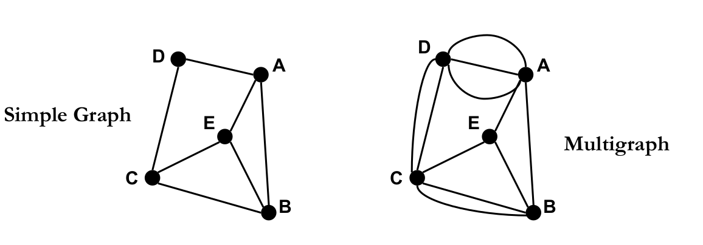
Multigraphs
Graphs that sometimes have multiple edges between the same pair of vertices
Non-multigraph graphs are called simple graphs
Taken from week 6 slides

Slide 57
Graph Representations
Two main types:
  Adjacency Lists
    Each vertex stores a list of the edges it is connected to, which store a reference to the vertices it connects
  Adjacency Matrices
    The graph stores a 2D Array where each row is a “list” (NOT list datatype) of every vertex that the vertex this row is representing is connected to (can just store 1/0 to represent adjacency, although it could also store the actual weight of the edge)
    Also needs a lookup for labels to access their index in the matrix, unless labels are integers starting from 0

Slide 58
Graph Traversal
More tricky than trees as there are no “leaf” nodes or “tails”
Could go on forever since they often loop on each other, so we need to keep track of vertices we’ve visited
Two basic traversal algorithms:
  Depth-first search
    Similar to pre-order traversal of a tree - go as deep along each path before returning
  Breadth-first search
    Checks every vertex level by level as you move away from the starting point

Slide 59
Depth-First Search
Uses G = (V, E) in adjacency list format
v = node on top of stack S
L[v] = adjacency list of v
Output: The DFS tree T
  Could be a queue of objects, or a string of labels, or a new graph (as a tree)

Slide 60
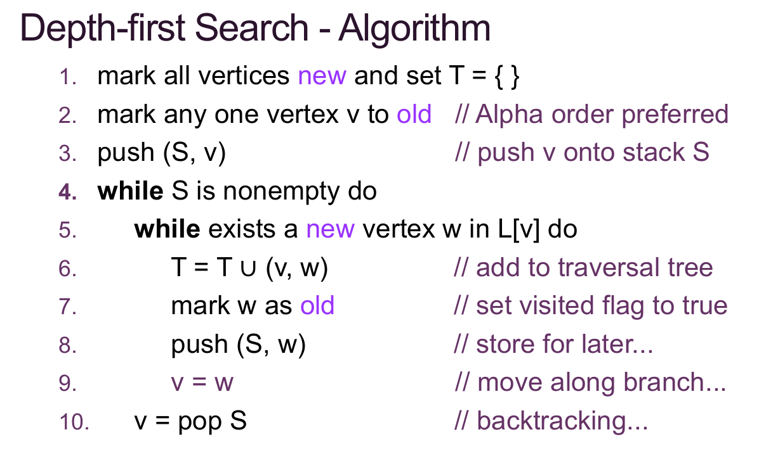
Depth-First Search Algorithm
Yes we just stole the
whole slide

Slide 61
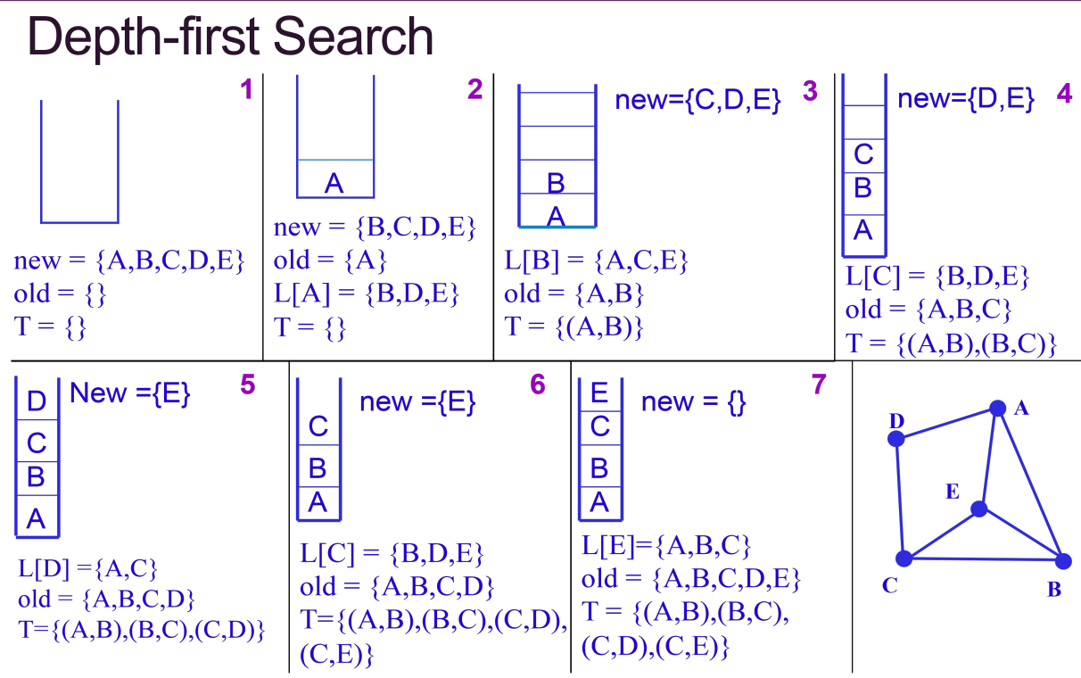
Depth-First Search Example
And we’d do it again

Slide 62
Breadth-First Search
Uses: G = (V, E)
v = value at front of queue Q
L[v] = adjacency list of v
Output: The BFS tree T

Slide 63
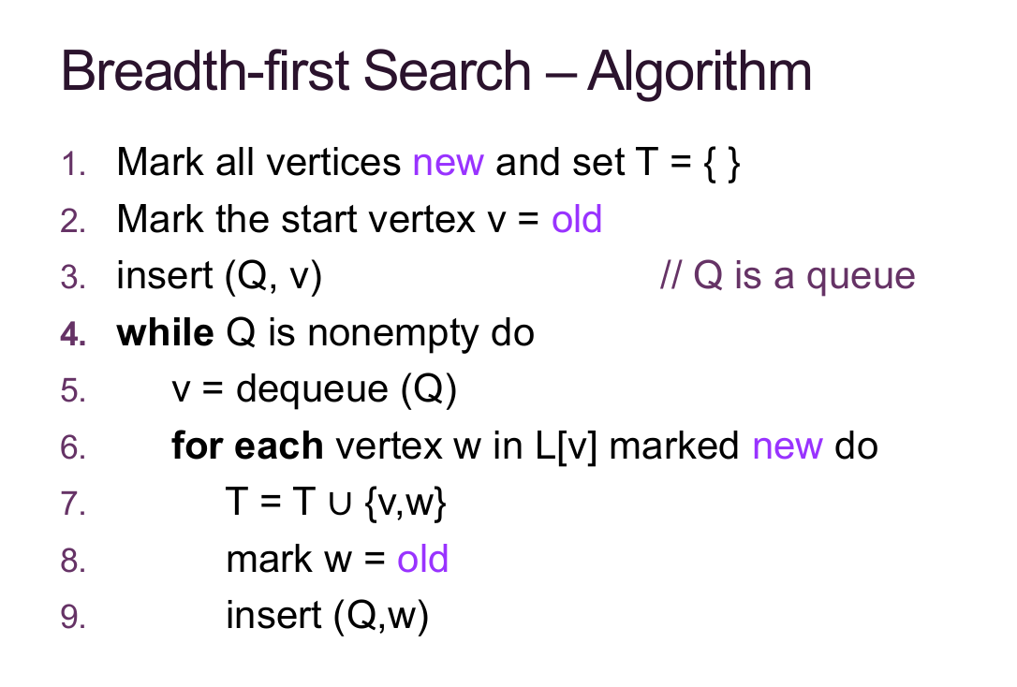
Breadth-First Search Algorithm
ComSSA has no shame

Slide 64
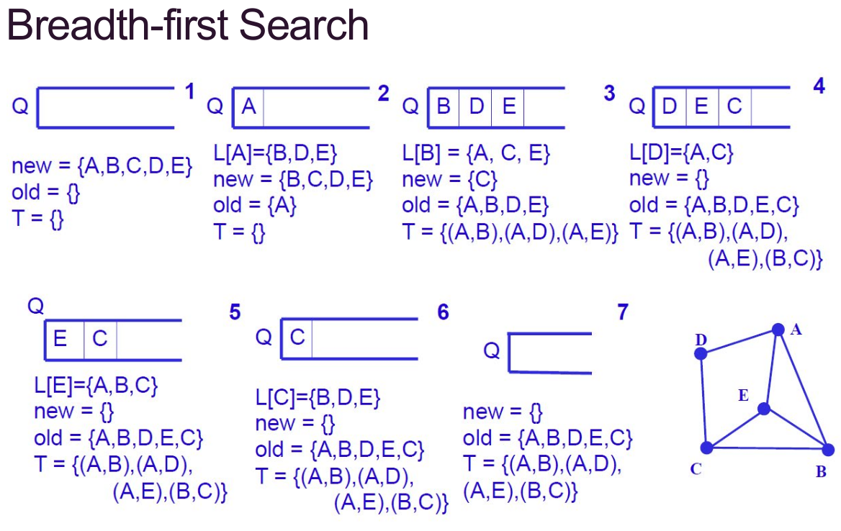
Breadth-First Search Example
Piracy is cool kids 😎

Slide 65
Writing it Out Like That Sucks!
Yes, we know, but you can be assessed on it in you rexam. Just be warned, and maybe don’t be lazy on it for the workshop.
Also, Graphs are super important - your assignment is mostly based off of one. We didn’t cover them muc because most of the issues with graphs are implementation details; make sure you put a lot of work into your graph for the prac and test it very thoroughly.

Slide 66
Revision Questions Time!

