Slide 1

Data Security Revision 2
ISEC2001/5006, Curtin University

Slide 2

Introduction
Six concepts in access control:
Identity
Set of attributes related to an entity
Accountability
Auditing, logging and reviewing
Identification
Who are you? Do you have a role?
Authentication
Knows / Has / Is (preferably 2FA)
Authorisation
You’re in. What access should you have?
Password Management
DAC / MAC / RBAC
Notes:
Notes to presenter:
Description of what you learned in your own words on one side.
Include information about the topic
Details about the topic will also be helpful here.
Tell the story of your learning experience. Just like a story there should always be a beginning, middle and an end.
On the other side, you can add a graphic that provides evidence of what you learned.
Feel free to use more than one slide to reflect upon your process. It also helps to add some video of your process.

Slide 3
Security Controls
Three types of security controls:
ADMINISTRATIVE Policies and procedures, risk management, security awareness training, change control procedures
TECHNICAL Implementing and maintaining access control mechanisms, passwords, firewalls etc
PHYSICAL Access to the site – buildings, departments, physical computers/servers, environment
Notes:
Notes to presenter:
Description of what you learned in your own words on one side.
Include information about the topic
Details about the topic will also be helpful here.
Tell the story of your learning experience. Just like a story there should always be a beginning, middle and an end.
On the other side, you can add a graphic that provides evidence of what you learned.
Feel free to use more than one slide to reflect upon your process. It also helps to add some video of your process.

Slide 4
Security Controls
Deterrent: controls to discourage attacks, e.g warning, banner, logon message, alarms
Preventive: Make it hard for attacks to succeed, e.g. firewall, encryption
Detective: Detect if attack has occurred e.g. checksum, IDS, rotation of duties, security audits
Corrective: Try to reverse the damage e.g. version control, incident handling procedures, fire extinguishers, undo/recycle bin
Recovery: Bring the system back after a major disaster e.g. recovery plan, hot/cold/warm sites, backup power
Notes:
Notes to presenter:
Description of what you learned in your own words on one side.
Include information about the topic
Details about the topic will also be helpful here.
Tell the story of your learning experience. Just like a story there should always be a beginning, middle and an end.
On the other side, you can add a graphic that provides evidence of what you learned.
Feel free to use more than one slide to reflect upon your process. It also helps to add some video of your process.

Slide 5
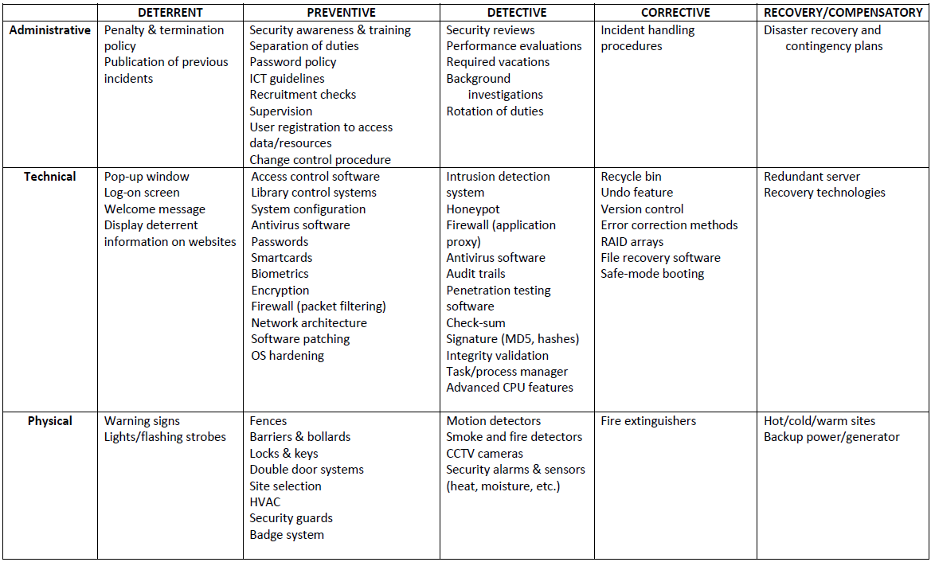
Security Controls
(Slide 25)
Notes:
Notes to presenter:
Description of what you learned in your own words on one side.
Include information about the topic
Details about the topic will also be helpful here.
Tell the story of your learning experience. Just like a story there should always be a beginning, middle and an end.
On the other side, you can add a graphic that provides evidence of what you learned.
Feel free to use more than one slide to reflect upon your process. It also helps to add some video of your process.

Slide 6
Security Methods
Least Privilege Only give users or systems the privileges they require.
Defense-in-Depth Security system should have multiple layers. Layers should be of different types.
Minimisation Systems should not run unnecessary applications or services.
Keep things simple Minimise avoidable complexity (that which is not needed to reduce risk). Keep it easy to design, implement, test and secure
Notes:
Notes to presenter:
Description of what you learned in your own words on one side.
Include information about the topic
Details about the topic will also be helpful here.
Tell the story of your learning experience. Just like a story there should always be a beginning, middle and an end.
On the other side, you can add a graphic that provides evidence of what you learned.
Feel free to use more than one slide to reflect upon your process. It also helps to add some video of your process.

Slide 7
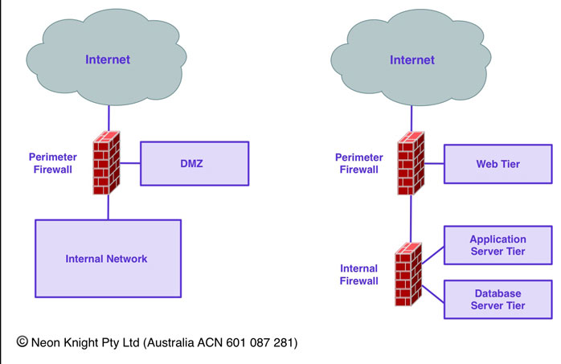
Security Methods
Compartmentalisation Use compartment design for system design/implementation
Notes:
Notes to presenter:
Description of what you learned in your own words on one side.
Include information about the topic
Details about the topic will also be helpful here.
Tell the story of your learning experience. Just like a story there should always be a beginning, middle and an end.
On the other side, you can add a graphic that provides evidence of what you learned.
Feel free to use more than one slide to reflect upon your process. It also helps to add some video of your process.

Slide 8
Security Methods
Use choke points Only allow traffic to travel in/out through choke points
Fail securely If a security control or measure fails, it is not rendered to an insecure state
Leverage unpredictability Don’t publicise your exact measures or defences
Separation of duties Don’t centralise security duties in one person, and don’t become overly dependent on one person.
Notes:
Notes to presenter:
Description of what you learned in your own words on one side.
Include information about the topic
Details about the topic will also be helpful here.
Tell the story of your learning experience. Just like a story there should always be a beginning, middle and an end.
On the other side, you can add a graphic that provides evidence of what you learned.
Feel free to use more than one slide to reflect upon your process. It also helps to add some video of your process.

Slide 9
Business Continuity (Part 1)
Prevention How to prevent incidents
Preparedness Business impact analysis – what’s the impact?
Response Incident response plan – what do we do?
Recovery How to recover after an incident / disaster
Notes:
Notes to presenter:
Description of what you learned in your own words on one side.
Include information about the topic
Details about the topic will also be helpful here.
Tell the story of your learning experience. Just like a story there should always be a beginning, middle and an end.
On the other side, you can add a graphic that provides evidence of what you learned.
Feel free to use more than one slide to reflect upon your process. It also helps to add some video of your process.

Slide 10
Business Continuity (Part 1)
Risk = Impact × Likelihood
Impact = the consequences / damage
Likelihood = the chance it will happen
Notes:
Notes to presenter:
Description of what you learned in your own words on one side.
Include information about the topic
Details about the topic will also be helpful here.
Tell the story of your learning experience. Just like a story there should always be a beginning, middle and an end.
On the other side, you can add a graphic that provides evidence of what you learned.
Feel free to use more than one slide to reflect upon your process. It also helps to add some video of your process.

Slide 11
Quantitative Risk Analysis
Single loss expectancy (SLE) = Asset value x Exposure factor
Annualised rate of occurrence (ARO)
Annualised loss expectancy (ALE) = SLE x ARO
Annual Cost of Safeguard (ACS) = the cost of the control
Cost Benefit Analysis (CBA) = the higher, the better!
Notes:
Notes to presenter:
Description of what you learned in your own words on one side.
Include information about the topic
Details about the topic will also be helpful here.
Tell the story of your learning experience. Just like a story there should always be a beginning, middle and an end.
On the other side, you can add a graphic that provides evidence of what you learned.
Feel free to use more than one slide to reflect upon your process. It also helps to add some video of your process.

Slide 12
Risk Management Strategies
Require no further action:
Accept – Note it in the risk register then do nothing
Avoid – Remove the part of the system which contains the risk
Transfer – Shifts risk – eg insurance, outsourcing*
Require action:
Mitigate – Reduce impact and/or reduce likelihood
Defend – Implement security controls and safeguards
Notes:
Notes to presenter:
Description of what you learned in your own words on one side.
Include information about the topic
Details about the topic will also be helpful here.
Tell the story of your learning experience. Just like a story there should always be a beginning, middle and an end.
On the other side, you can add a graphic that provides evidence of what you learned.
Feel free to use more than one slide to reflect upon your process. It also helps to add some video of your process.

Slide 13
The End
Thank you!

