Slide 1
ComSSA FOP Revision
Week 8 (2023 Edition)

Slide 2
Variables and Data Types
Python has four basic data types:
Integers | int | Whole numbers | 7, −55, 32000
Floats | float | Real numbers | 256.0, −35.768
Strings | str | Any text or characters | “Rats are cool”
Boolean | boolean | True or False | True, False

Slide 3
Variables and Data Types
Python is unusual because:
You don’t need to declare variables (though may have to initialise them)
Python can work out which type a variable should be (Dynamic typing)
name = "ComSSA" – is a string
year = 2022 – is an int
myFOPGrade = 97.5 – is a float, and can be a real number if you work hard
ratsRock = True – is a boolean.

Slide 4
Variables and Data Types
If a variable is an int or float, it is a number.
This means you can use it like a number anywhere a number is used!

Slide 5
A Python program
# circle.py - a quick program to calculate area and circumference
# of a circle with a radius input by the user.
pi = 3.1415927
radius = float(input("Enter desired radius: ")) # get input from user
if radius < 0:
print("Radius can't be negative!")
elif radius == 0:
print("Radius must be a positive number")
else:
print("\nRadius:", radius, "units")
print("Area:", round(pi * radius**2, 4), "units squared")
print("Circumference:", round(2 * pi * radius, 4), "units")

Slide 6
A Python program
Comment
# circle.py - a quick program to calculate area and circumference
# of a circle with a radius input by the user.
pi = 3.1415927
radius = float(input("Enter desired radius: ")) # get input from user
if radius < 0:
print("Radius can't be negative!")
elif radius == 0:
print("Radius must be a positive number")
else:
print("\nRadius:", radius, "units")
print("Area:", round(pi * radius**2, 4), "units squared")
print("Circumference:", round(2 * pi * radius, 4), "units")
Assignment
Print function
Indentation

Slide 7
A Python program
# circle.py - a quick program to calculate area and circumference
# of a circle with a radius input by the user.
pi = 3.1415927
radius = float(input("Enter desired radius: ")) # get input from user
if radius < 0:
print("Radius can't be negative!")
elif radius == 0:
print("Radius must be a positive number")
else:
print("\nRadius:", radius, "units")
print("Area:", round(pi * radius**2, 4), "units squared")
print("Circumference:", round(2 * pi * radius, 4), "units")
Type conversion
Boolean expressions
Control structure (If − Elif − Else)
No end!! (This is normal)

Slide 8
More control structures : For loop
A “for” loop looks like this:
for i in range(max):
Or can look like this:
for word in words:
They do different things.

Slide 9
More control structures : For loop
Loop counter /
Index variable
0, 1, 2, 3, 4 … max−1
(max is “Stop Value”)
A “for” loop looks like this:
for i in range(max):
Or can look like this:
for word in words:
They do different things.
i is a number
word is part of words

Slide 10
More control structures : For loop
Each time it goes through the loop, it runs the indented code under it.
for i in range(5):
print("Now I am", i)
print("And now I'm done.")
Or…
words = ['this', 'is', 'a', 'loop']
for word in words:
print(word)
Now I am 0
Now I am 1
Now I am 2
Now I am 3
Now I am 4
And now I'm done.
this
is
a
loop

Slide 11
More control structures: While loop
A while loop runs while its expression is True, and stops when it is False.
Have to be careful − Infinite loops (where the condition is always true!)
choice = input("Please enter Y or N")
while choice != 'Y' and choice != 'N':
print("Invalid choice!")
choice = input("Please enter Y or N")
print("You entered:", choice)
!= means "not equal to"

Slide 12
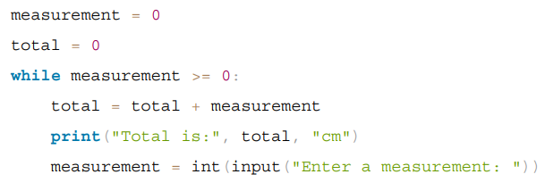
More control structures: While loop
Another example:

Slide 13
Strings
A string is a series of characters − they could be letters, numbers, or something else entirely. In Python we use double quotes (" ") to note something is a string.
myString = "Welcome to the ComSSA FOP Revision Session!"
You CAN use a single quote e.g. 'hello', but they’re less flexible.
Never mix them.

Slide 14
Strings and Slicing
If you want to get a single character in a string, you must count from zero. For example, the 2nd character is myString[1].
To get substrings, use the following:
start:stop:step
Start: index of the character it starts on (Default = 0)
Stop: index of the character AFTER the last one you want to include (Default = end)
Step: how much you want it to jump each time (Default = 1)

Slide 15
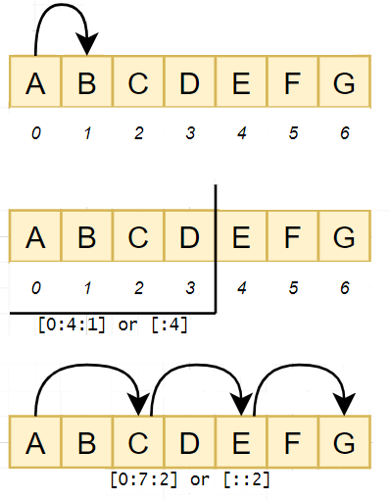
Strings and Slicing
Start: First character
Stop: The character AFTER the last one you want to include
Step: The jump between characters

Slide 16
Strings and Slicing
myString = "Welcome to the ComSSA FOP Revision Session!"
myString[0] = ______
myString[5:7] = ______
len(myString) = 43 # what does this mean?
myString[42] = ______
myString[6:−1:−1] = ______
0 1 2 3 4 5 6 7 8 9 10...

Slide 17
Lists
A structure which can hold any type of item
Is composed of elements
myString = "Welcome to the ComSSA FOP Revision Session!"
myList = myString.split(" ")
["Welcome", "to", "the", "ComSSA", "FOP", "Revision", "Session!"]

Slide 18
Lists
You can do slicing on lists too:
["Welcome", "to", "the", "ComSSA", "FOP", "Revision", "Session!"]
myList[3] = _____
myList[::2] = _____
myList.append(":D")
del myList[2]

Slide 19
Arrays
Arrays hold an ordered sequence of values.
Unlike lists:
All of the elements must be the same type
− for example, all ints, or all strings.
Once you create it, you can only change the size by creating a new array and copying the elements from one to the other.
Slicing also works on arrays.

Slide 20
Arrays
To use arrays, this must be at or near the very top of your code:
import numpy as np
You can create arrays by a number of methods:
myArray = np.array(myList) # converting from list
myArray = np.zeros(100) # creates an array
# of 100 numbers,
# all equal to 0
fives = np.arange(0,55,5) # [0, 5, 10... 50]

Slide 21
Arrays
0
1
2
You can manipulate arrays:
myArray[2:4] = 0
a = np.array([1, 2, 3])
a3 = a * 1.05
print(a3)
print(a3.max())
print(a3.mean())
# sets elements 2 and 3 to 0
→ [1.05, 2.10, 3.15]
→ 1.05
→ 2.10

Slide 22
Arrays - Multidimensional
0,0
0,1
0,2
1,0
1,1
1,2
Multidimensional arrays are a lot like normal arrays. The differences:
Declaring:
myArray = np.zeros(100) my3DArray = np.zeros((100, 100, 100))
myArray = np.array([1, 2, 3]) my2DArray = np.array([[1, 2], [3, 4]])
Accessing:
myArray[2, :, :] # means all rows, all columns, 2nd table
myArray[:, :5, :] # means all rows up to 4, all columns, all tables
Double brackets important

Slide 23
Arrays - Multidimensional
To loop through multidimensional arrays, we need multiple loops:
for row in range(len(myArray[:, 0])):
for column in range(len(myArray[0, :])):
print("Value at [", row, column, "] is:”, \
myArray[row, column])
Note myArray[row, column] can also be written myArray[row][column]

Slide 24
Functions
Functions are a great way of making our code more efficient.
Instead of having to do the same thing multiple times with only slightly different options, we can do it once, then call it multiple times. Not only shorter, but a lot easier to understand.

Slide 25
Functions
inputs
A typical function looks like this:
def sum_of_squares(a, b):
output = (a * a) + (b * b)
return output
It would be called in code like this:
myNum = sum_of_squares(3, 5)
Inputs from outside
Output sent to outside
return

Slide 26
Functions
Understanding scope is important!
Variables inside a function mean nothing outside of it.
In the last example, if you did “print(output)” in the main code, it would have an error. Likewise, if you tried to do something with mynum inside the function, it would not work (or if it somehow did, it may behave unpredictably).
And see how “3” in the main code became “a” in the function,
and “5” became “b”?

Slide 27
Plotting
Matplotlib works by building up a buffer of things to show, kind of like a storyboard for an animation.
It then “presses play” when you run plt.show()
(This should usually only run at the very end, as it empties the buffer)
For a lot of things you should define axes and work on these
(As we’ve seen in Prac Test 1 and 2).

Slide 28
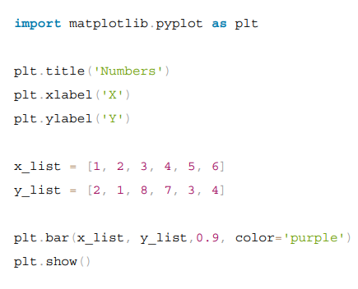
Plotting

Slide 29
Plotting
0, 0
0, 1
What do you think this code does?
fig, axs = plt.subplots((2, 2))
axs[0, 0].set_xlim(0, 36)
axs[0, 0].set_ylim(0, 36)
axs[0, 0].set_facecolor(“black”)
axs[0, 0].set_title(“The void.”)
axs[1, 1].set_facecolor(“blue”)
axs[1, 1].plot([0,0], [35,35], “white”)
plt.show()
1, 0
1, 1

Slide 30
Files
Reading and writing to files is essential to programming. Usually, you will be working with CSV (Comma Separated Value) text files, which look something like this:
20908070,Joe Bloggs,COMP1005,85.0
20807060,John Smith,NPSC1003,60.0
20607080,Tess Jones,STAT1005,80.0

Slide 31
Files
Two ways to open files for reading:
with open("file.csv") as f:
lines = f.readlines()
f = open("file.csv")
lines = f.readlines()
f.close()

Slide 32
Files
Once we have the data, we need to process it. readlines() creates a list of lines in the file (just long strings, they look meaningful to us but mean nothing to Python). To start processing them, we need to split them up. For example:
itemslist = [] # creates empty list
for line in lines:
a = line.split(",") # split "a,b" into ["a","b"]
itemslist.append(a[0]) # adds to our list

Slide 33
Objects
An object is a instance of a class. Classes have attributes.
This room has a building number, a room number,
and the number of people it is allowed to hold.
A cat or dog has a breed, a name and a date of birth.
A student has a student ID number and a name.

Slide 34
Objects
An object is a instance of a class. Classes also have methods.
Methods are functions that belong to classes. They do stuff.
What are some methods a Cat class might have?
(Not technical at all – think of an actual cat)

Slide 35
Objects
Do you remember earlier in programming, when you had to put round brackets
at the end of some things?
e.g. print( myString.upper() )
myList.append(5)
f.readlines()
plt.show()
You were using a method!
And if you didn’t have to use the brackets, you were accessing a variable.
e.g. lights[i,j].colour

Slide 36
Objects
Creating a class is easy. We need an __init__ method to initialise the class variables.
class Car:
def __init__ (self, model, colour, numberplate, kms):
self.model = model
self.colour = colour
self.numberplate = numberplate
self.kms = kms
def display(self):
print ("I am a", self.colour, self.model , \
"with numberplate", self.numberplate )
Class
variables
Just normal variables!

Slide 37
Objects
You’ll get used to this “self” thing – it appears everywhere. It refers to the particular object created by the class.
class Car:
def __init__ (self, model, colour, numberplate, kms):
self.model = model
self.colour = colour
self.numberplate = numberplate
self.kms = kms
def display(self):
print ("I am a", self.colour, self.model , \
"with numberplate", self.numberplate )

Slide 38
Objects
All methods have “self” as their first parameter.
So for example:
def walk(self, start, end, shoes):
We would call this method like this:
self.walk(“B314”, “Library”, “hiking boots”)
If we didn’t have the “self.”, Python wouldn’t know where to find it or what it belongs to. While it looks like a function, it is a method of a class.

Slide 39
Objects
If we didn’t have initial values, it looks a bit different.
class Demo:
def __init__ (self):
self.name = ""
self.start = None
self.end = None
You’ll have to set them later.

Slide 40
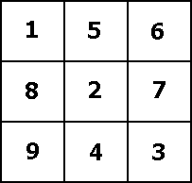
Activity 1 – Functions and Arrays
Write a function to return the number of characters in your first name.
Write a function to return your initials as a list.
Write code which creates a 2-dimensional array with 9 numbers in it.
Print the middle square.
(Hint for first two – name.split(" ") splits a string by space into a list.)

Slide 41
Solution 1 – Functions and Arrays
Write a function to return the number of characters in your first name.
def lenFirst(name):
splitName = name.split(" ")
return splitName[0]

Slide 42
Solution 1 – Functions and Arrays
2. Write a function to return your initials as a list.
def initials(name):
splitName = name.split(" ")
initials = []
for i in splitName:
initials.append(i[0])
return initials
OR
initials = [splitName[0][0], splitName[-1][0]] (no need for for loop with this version)

Slide 43
Solution 1 – Functions and Arrays
Write code which creates a 2-dimensional array with 9 numbers in it.
Print the middle square.
import numpy as np
myArray = np.array([[1, 5, 6], [8, 2, 7], [9, 4, 3]])
print(myArray[1, 1])

Slide 44
Activity 2 - Objects
Choose a pet – yours or just one you like.
Design a class of that type (e.g. Cat, Dog, Budgie, GuineaPig etc) and give it some reasonable attributes - its name, colour, date of birth for example – there are no right or wrong answers. Write a def __init__ for it like the ones you’ve seen in this session.
Now, create an instance (object) for your pet using the class you’ve just written.
Talk with your table group and try some of theirs! Were there any differences with yours?
How would you print or access the variables for your pet? What methods might you write for it? (Note: you don’t have to actually write the methods)

Slide 45
Thank you for attending this ComSSA revision session!

